Slide 1

What is Pi?
Notes:
Ratio of Circumference over Diameter
Irrational Number - cannot be expressed as a fraction, do not terminate, nor do they repeat
Interesting read about the history of pi: https://www.exploratorium.edu/pi/history_of_pi/

Slide 2
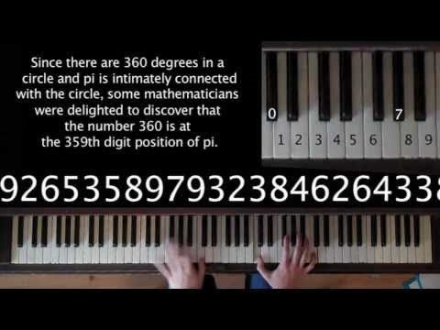
Song from pi

Slide 3
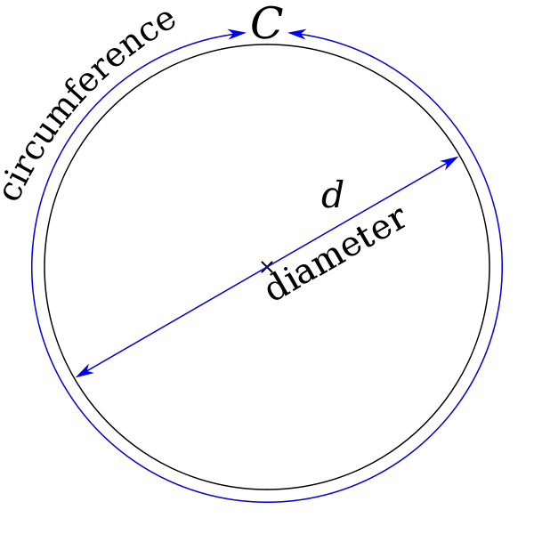
Pi
Pi = ratio of a circle’s circumference to its diameter
π = C / d
= C / 2r
C = 2πr
Other uses of pi
Area of circle = πr²
Volume of sphere = ⁴/₃πr³
Surface area of sphere = 4πr²

Slide 4
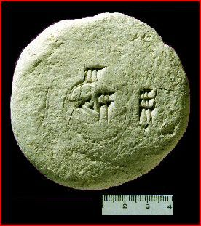
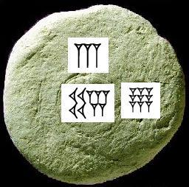
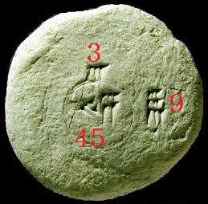
Babylonians
Notes:
https://numberwarrior.wordpress.com/2008/12/03/on-the-ancient-babylonian-value-for-pi/

Slide 5
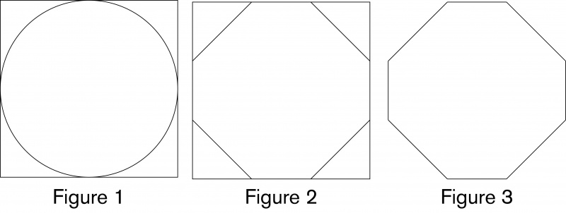
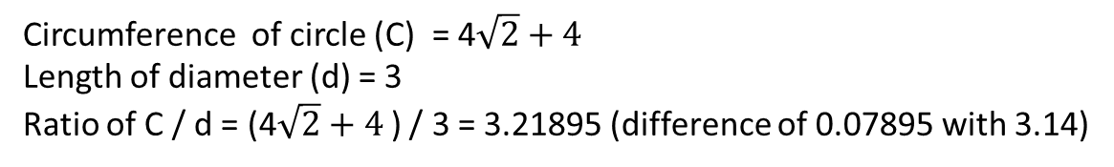

Egyptians (1650 BC)
$√2$units
1 unit
1 unit
Circumference of circle (C) = 4$\sqrt{2}+4$
Length of diameter (d) = 3
Ratio of C / d = (4$\sqrt{2}+4$) / 3 = 3.21895 (difference of 0.07895 with 3.14)
Notes:
The ancient Egyptians had a method, documented around 1650 BC in the Rhind Mathematical Papyrus, of calculating the area of a circle without π as we now know it. They took a square with side length equal to the diameter of the circle (Figure 1), trisected each side and removed the corner triangles (Figure 2) and used the remaining octagonal shape (Figure 3) to approximate the area of the circle. Using this method, what would be the calculated circumference of the ‘circle’ with diameter 3 units?

Slide 6
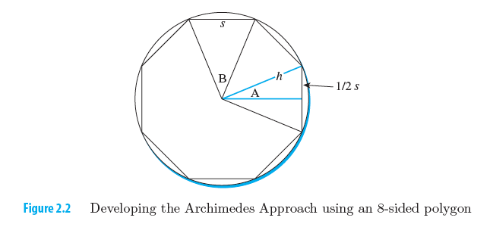
Archimedes Approach
Notes:
https://betterexplained.com/articles/prehistoric-calculus-discovering-pi/

Slide 7
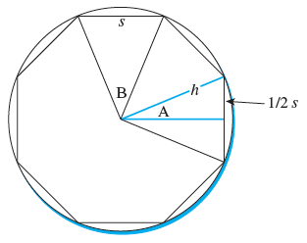
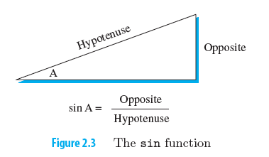
Archimedes Approach
>>> import math
>>> noSides = 8
>>> innerangleB = 360.0 / noSides
>>> halfangleA = innerangleB / 2
>>> onehalfsideS = math.sin(math.radians(halfangleA))
>>> sideS = onehalfsideS * 2
>>> polygonCircumference = noSides * sideS
>>> pi = polygonCircumference / 2
>>> pi
3.0614674589207183
>>>

Slide 8

Functions
In Python, a function is a named sequence of statements that belong together. Their primary purpose is to help us organize programs into chunks that match how we think about the problem.
The syntax for a function definition is:

Slide 9
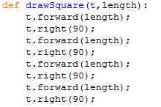
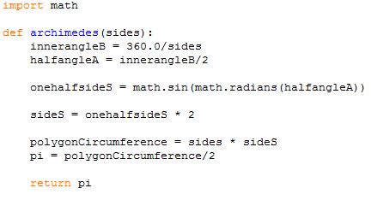
Functions

Slide 10
Develop a Pi Function
Use abstraction to think about a collection of steps as a logical group
return statement causes:
Contained expression to be evaluated and returned
The function archimedes will terminate immediately and the reference to the result object will be returned to the calling statement
import math
def archimedes(noSides):
innerangleB = 360.0/ noSides
halfangleA = innerangleB/2
onehalfsideS = math.sin(math.radians(halfangleA))
sideS = onehalfsideS * 2
polygonCircumference = noSides * sideS
pi = polygonCircumference/2
return pi
>> archimedes(10)
3.090169943749474
>> archimedes(100)
3.141075907812829
>> archimedes(1000)
3.141587485879563
>> archimedes(10000)
3.141592601912665
>> archimedes(100000)
3.1415926530730216

Slide 11


More Pi Approximations
Using infinite series
Leibniz:
Using infinite product expansions
Wallis:

Slide 12
Accumulator Pattern
1 + 2 + 3 + 4 + 5
Or 1 + 2 + 3 + 4 + .... + 10
Or 1 + 2 + 3 + ... + 100
acc = 0 #initialisation
for x in range (1,6):
acc = acc + x
print(acc)
x
1 2 3 4 5
+
+
+
+
+
0
1
3
6
10
15
acc

Slide 13

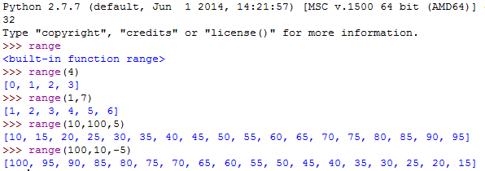
for loop
Definite loop

Slide 14
Compute the sum of the first 50 odd numbers
L2_ICE1

Slide 15
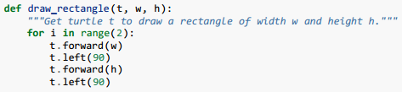
Functions can call other functions
There are some points worth noting here:
Functions can call other functions.
Rewriting draw_square like this captures the relationship that we’ve spotted.
A caller of this function might say draw_square(tess, 50).
The parameters of this function, tx and sz, are assigned the values of the tess object, and the int 50 respectively.
In the body of the function they are just like any other variable.
When the call is made to draw_rectangle, the values in variables tx and sz are fetched first, then the call happens. So as we enter the top of function draw_rectangle, its variable t is assigned the tess object, and w and h in that function are both given the value 50.
Notes:
So far, it may not be clear why it is worth the trouble to create all of these new functions. Actually, there are a lot of reasons, but this example demonstrates two: 1. Creating a new function gives you an opportunity to name a group of statements. Functions can simplify a program by hiding a complex computation behind a single command. The function (including its name) can capture your mental chunking, or abstraction, of the problem. 2. Creating a new function can make a program smaller by eliminating repetitive code.
As you might expect, you have to create a function before you can execute it. In other words, the function definition has to be executed before the first time it is called.
Execution always begins at the first statement of the program. Statements are executed one at a time, in order from top to bottom.
Function definitions do not alter the flow of execution of the program, but remember that statements inside the function are not executed until the function is called. Although it is not common, you can define one function inside another. In this case, the inner definition isn’t executed until the outer function is called
Function calls are like a detour in the flow of execution. Instead of going to the next statement, the flow jumps to the first line of the called function, executes all the statements there, and then comes back to pick up where it left off. That sounds simple enough, until you remember that one function can call another. While in the middle of one function, the program might have to execute the statements in another function. But while executing that new function, the program might have to execute yet another function! Fortunately, Python is adept at keeping track of where it is, so each time a function completes, the program picks up where it left off in the function that called it. When it gets to the end of the program, it terminates.

Slide 16
Parameters and Arguments
Some of the built-in functions we have seen require arguments. For example, when you call math.sin you pass a number as an argument. Some functions take more than one argument: math.pow takes two, the base and the exponent.
Inside the function, the arguments are assigned to variables called parameters. Here is an example of a user-defined function that takes an argument:
def print_twice(bruce):
print (bruce )
print (bruce )
This function assigns the argument to a parameter named bruce. When the function is called, it prints the value of the parameter (whatever it is) twice.
This function works with any value that can be printed.
>>> print_twice('Spam')
Spam Spam
>>> print_twice(17)
17 17
>>> print_twice(math.pi)
3.14159265359 3.14159265359

Slide 17
Variables and parameters are local
When you create a variable inside a function, it is local, which means that it only exists inside the function. For example:
def cat_twice(part1, part2): cat = part1 + part2 print_twice(cat)
This function takes two arguments, concatenates them, and prints the result twice. Here is an example that uses it:
>>> line1 = 'Bing tiddle’
>>> line2 = 'tiddle bang.’
>>> cat_twice(line1, line2)
Bing tiddle tiddle bang. Bing tiddle tiddle bang

Slide 18
Variables and parameters are local
When cat_twice terminates, the variable cat is destroyed. If we try to print it, we get an exception:
>>> print( cat )
NameError: name 'cat' is not defined
Parameters are also local. For example, outside print_twice, there is no such thing as bruce.

Slide 19
Fruitful function vs void function
Some of the functions we are using, such as the math functions, yield results; for lack of a better name, I call them fruitful functions. Other functions, like print_twice, perform an action but don’t return a value. They are called void functions.
When you call a fruitful function, you almost always want to do something with the result; for example, you might assign it to a variable or use it as part of an expression:
x = math.cos(radians)
golden = (math.sqrt(5) + 1) / 2

Slide 20
Fruitful function vs void function
When you call a function in interactive mode, Python displays the result:
>>> math.sqrt(5)
2.2360679774997898
But in a script, if you call a fruitful function all by itself, the return value is lost forever!
math.sqrt(5)
This script computes the square root of 5, but since it doesn’t store or display the result, it is not very useful.

Slide 21
return
Fruitful functions
Void functions
def square(x):
y = x * x
return y
def sumOfN(n):
acc = 0
for x in range(1,n+1):
acc = acc + x
return acc
def print_twice(bruce):
print(bruce)
print(bruce)
return
def drawSquare(t, len):
for x in range(1,n+1):
t.forward(len)
t.left(90)
return

Slide 22
Void functions
Void functions might display something on the screen or have some other effect, but they don’t have a return value.
If you try to assign the result to a variable, you get a special value called None.
>>> result = print_twice('Bing')
Bing Bing
>>> print(result)
None
The value None is not the same as the string 'None'. It is a special value that has its own type:
>>> print type(None)
<type 'NoneType'>

Slide 23
Why functions?
It may not be clear why it is worth the trouble to divide a program into functions. There are several reasons:
Creating a new function gives you an opportunity to name a group of statements, which makes your program easier to read and debug.
Functions can make a program smaller by eliminating repetitive code. Later, if you make a change, you only have to make it in one place.
Dividing a long program into functions allows you to debug the parts one at a time and then assemble them into a working whole.
Well-designed functions are often useful for many programs. Once you write and debug one, you can reuse it.

Slide 24


Summation of Terms: Leibniz Formula
All numerators are 4
The denominators are all odd numbers
The sequence alternates between addition and subtraction
The accuracy of the approximation depends on how many terms are used.
def leibniz(terms):
acc = 0.0
num = 4.0
den = 1
for aterm in range(terms):
nextterm = num/den * (-1)**aterm
acc = acc + nextterm
den = den + 2
return acc
Leibniz
Number
of terms
Pi
Abstraction for the Leibniz formula

Slide 25

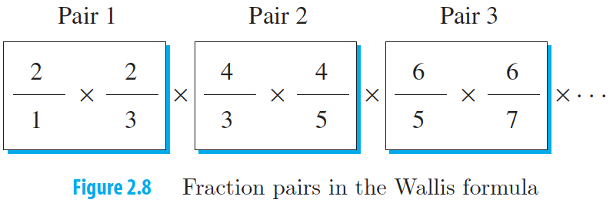
Product of Terms: Wallis
Accumulator variable = 1
Relationship between each pair of terms
def wallis(pairs):
acc = 1.0
num = 2.0
for apair in range(pairs):
leftterm = num /(num-1)
rightterm = num /(num+1)
acc = acc * leftterm * rightterm
num = num + 2
pi = acc * 2
return pi
num
num
x
num – 1
num + 1

Slide 26
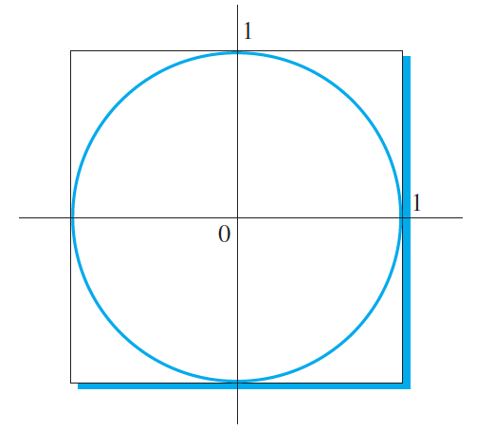
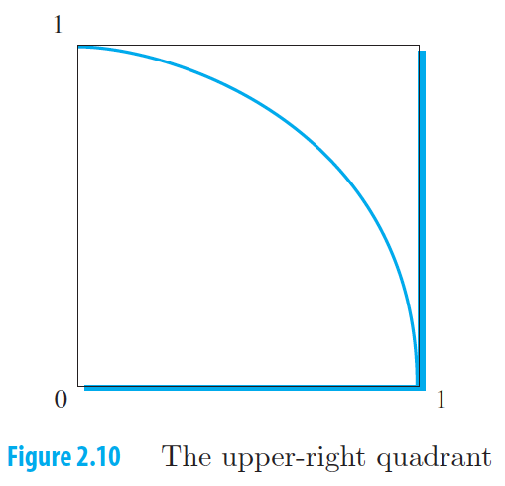
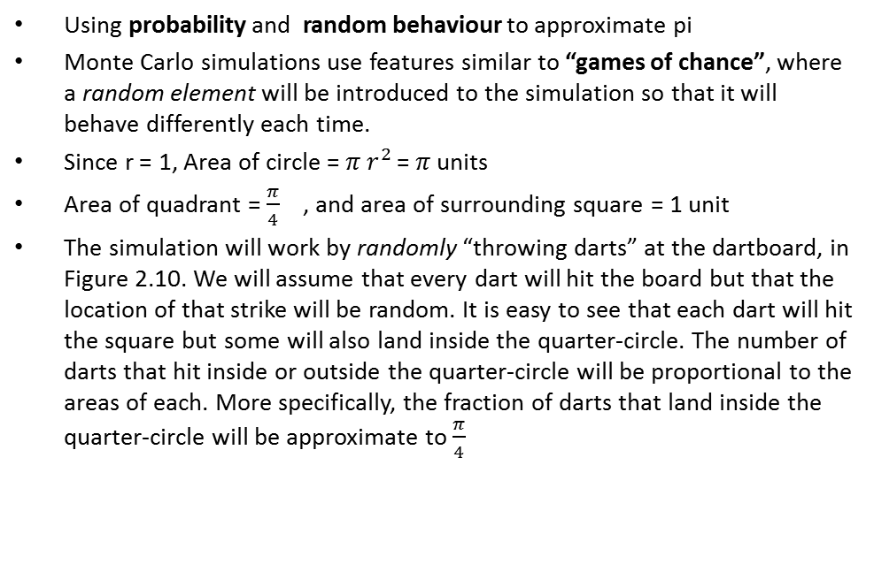
Monte Carlo Simulation
Using probability and random behaviour to approximate pi
Monte Carlo simulations use features similar to “games of chance”, where a random element will be introduced to the simulation so that it will behave differently each time.
Since r = 1, Area of circle = $π r^{2 }$= $π$ units
Area of quadrant = $\frac{π}{4}$ , and area of surrounding square = 1 unit
The simulation will work by randomly “throwing darts” at the dartboard, in Figure 2.10. We will assume that every dart will hit the board but that the location of that strike will be random. It is easy to see that each dart will hit the square but some will also land inside the quarter-circle. The number of darts that hit inside or outside the quarter-circle will be proportional to the areas of each. More specifically, the fraction of darts that land inside the quarter-circle will be approximate to $\frac{π}{4}$

Slide 27
random module
The random number generator returns a floating-point number between 0 and 1 each time it is called.
We will use this to generate two numbers between 0 and 1, namely, the x-coordinate and y-coordinate of the dart point.
In order to know whether this randomly chosen point is inside or outside of the quarter circle, we need a few new ideas.
>>> import random
>>> random.random()
0.5917485257879475
>>> random.random()
0.5514326989643525
>>> for i in range(5):
print(random.random())
0.978005968341
0.977985355575
0.0335041797943
0.934864962738
0.757895275405
>>>

Slide 28
Importing with import
Python provides two ways to import modules; we have already seen one:
>>> import math
>>> print(math)
<module 'math' (built-in)>
>>> print(math.pi)
3.14159265359
If you import math, you get a module object named math. The module object contains constants like pi and functions like sin and exp.
But if you try to access pi directly, you get an error.
>>> print(pi)
Traceback (most recent call last):
File "<stdin>", line 1, in <module>
NameError: name 'pi' is not defined

Slide 29
Importing with from
As an alternative, you can import an object from a module like this:
>>> from math import pi
Now you can access pi directly, without dot notation.
>>> print(pi)
3.14159265359
Or you can use the star operator to import everything from the module:
>>> from math import *
>>> cos(pi)
-1.0
The advantage of importing everything from the math module is that your code can be more concise.
The disadvantage is that there might be conflicts between names defined in different modules, or between a name from a module and one of your variables.

Slide 30
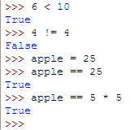
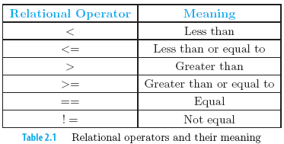
Boolean expression
To solve the problem of deciding whether the point is inside / outside the quarter-circle, we need to be able to ask a question.
In computer science, a question is referred to as a Boolean expression, which results in Boolean data values, True or False.
Simple Boolean expressions

Slide 31
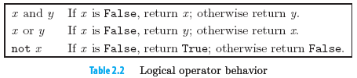
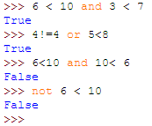
Compound Boolean Expressions
Composed of simple boolean expressions that are connected by logical operatorsand, or, not

Slide 32

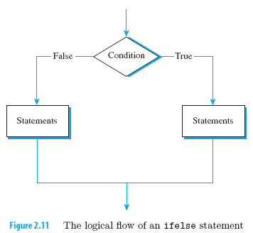
Selection Statements
In computer science, decisions are often called selection because we wish to select between possible outcomes based on the result of the question we have asked.
Up until now, the statements in our programs have been executed in sequence, one at a time, in the order that they were written.
If-Else statement will contain a question and other groups of statements that may or may not be executed, depending on the result of the question
>>> c
10
>>> a = 5
>>> b = 3
>>> if a > b:
c = 10
else:
c = 20
>>> c
10
>>>

Slide 33

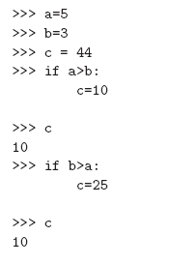
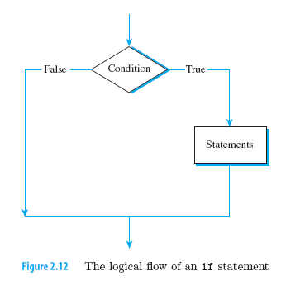
If Statement

Slide 34
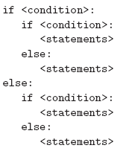
Nested Selection
wearGlasses = False
height = 165
if wearGlasses:
if height < 165:
print("Not Eligible")
else:
print("Go for eye screening")
else:
if height < 165:
print("Probationary acceptance")
else:
print("Eligible")

Slide 35
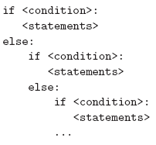
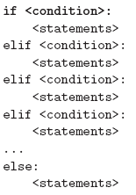
Tail Nesting
With tail nesting, all of the nested selection occurs in the else of the previous ifelse statement.
This is such a common pattern such that Python provides a shorter version known as the elif statement

Slide 36
L2_ICE4: Scores
Write a nested selection using ifelse that sets the value of a variable gradepoint to 4 if a variable named score is greater than 90, 3 if score is between 80 and 89, 2 if score is between 70 and 79, 1 if score is between 60 and 69, and 0 otherwise.
Rewrite the above, using elif statement

Slide 37
Write a function montePi(darts) that accepts a number of darts and returns the approximate pi based on the ratio of darts in the quarter circle and the surrounding square
L2_ICE5

Slide 38
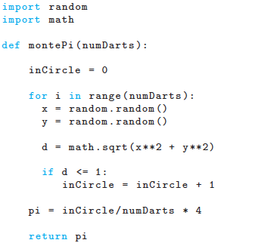
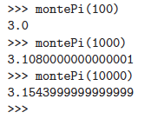
Monte Carlo Approximation
Formula for finding the distance between a point (x, y) and the origin (0, 0):
Notes:
A Monte Carlo method is a stochastic technique, meaning that it is based on using random numbers and probability to investigate problems. Monte Carlo methods are employed in a wide variety of fields including economics, finance, physics, chemistry, engineering, and even the study of traffic flows. Each field using Monte Carlo methods may apply them in different ways, but in essence they are using random numbers to examine some problem and approximate its outcome. As such Monte Carlo methods give us a way to model complex systems that are often extremely hard to investigate with other types of techniques.
"The term 'Monte Carlo' was introduced by von Neumann and Ulam during World War II, as a code word for the secret work at Los Alamos; it was suggested by the gambling casinos at the city of Monte Carlo in Monaco. The Monte Carlo method was then applied to problems related to the atomic bomb." ( Simulation and the Monte Carlo Method by Reuven Y. Rubinstein, John Wiley & Sons, Inc., New York, 1981, p.11.) For a brief history of Monte Carlo Methods see http://stud2.tuwien.ac.at/~e9527412/history.html.
It is well known that to approximate the probability of obtaining a head in coin tossing, we may toss the coin repeatedly, counting the number of heads obtained, and then divide that number by the total number of tosses. This simple idea has extensions to more complex experiments. For a specified event, perform the experiment repeatedly, count the number of favorable outcomes, and then divide that number by the total number of times you perform the experiment. We would like to use this idea to determine the relationship between probability and area by performing a sequence of simulations.

Slide 39
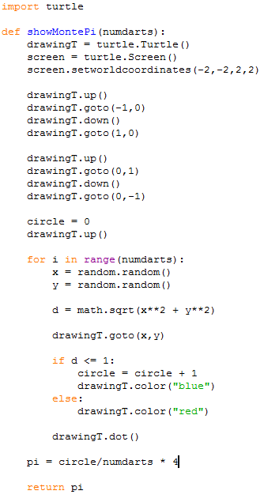
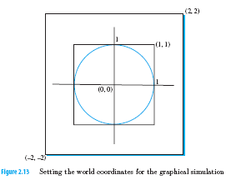
Adding the Graphics

Slide 40
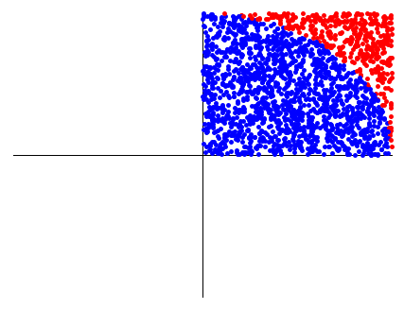
Calling showMontePi(2000)

Slide 41
Summary
We have looked at some new building blocks to programming
Math modules (like sin, random)
Boolean expressions
Selection Statements
Accumulator pattern
Monte Carlo simulation technique

